Slide 1
COMPSYS302 Project B
Marcus Wong
mwon724

Slide 2
Overview:
Brief
Requirements
User can login to system, shows other online users
User interacts with other clients by sending/receiving messages and files
User can create and maintain a profile while also viewing others
Additional requirements developed on an ongoing basis (with consultation from client)

Slide 3
Login-P2P Hybrid Model
Justification
Core client concern: privacy and security
Desire to move away from network models that ‘could be monitored’
Current implementation decentralises data storage, reducing dependency (risk) in the case of data compromise
Localised data storage with SQLite, server is purely for authentication
Low server upkeep costs, server compromise would not (immediately) lead to mass-leakage of data
Login server is more easily scalable; can easily add new users
Lower development time compared to pure peer to peer

Slide 4
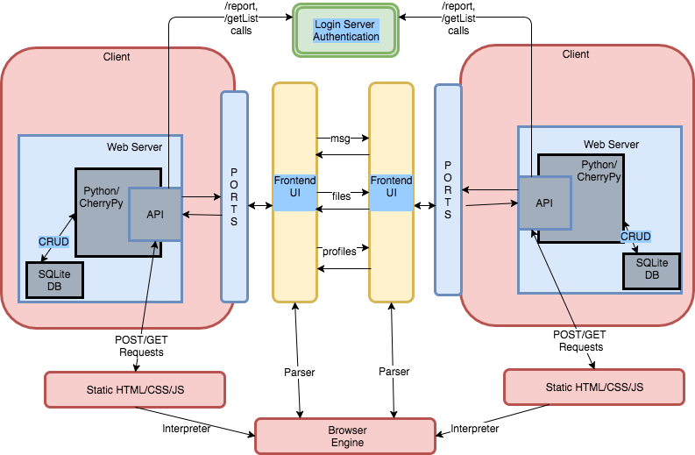
Top-level System View

Slide 5

Technology
Stack
Discussion
Python & CherryPy
HTML/CSS/JS
SQLite
Suggested: REST Clients for JSON validation/API request debugging (e.g. Insomnia)

Slide 6
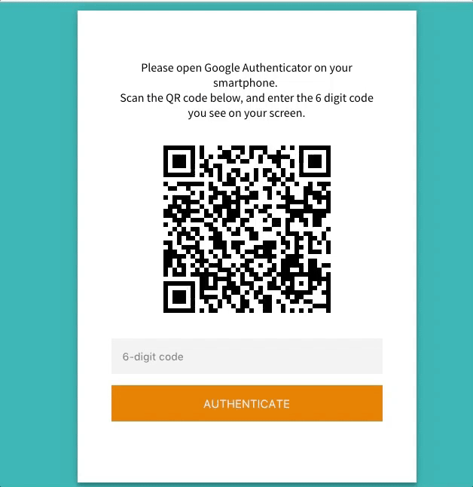
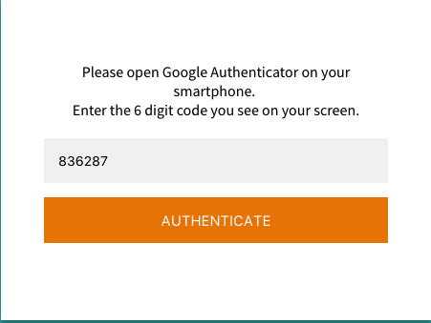
Special Features:
Two Factor
Authentication

Slide 7
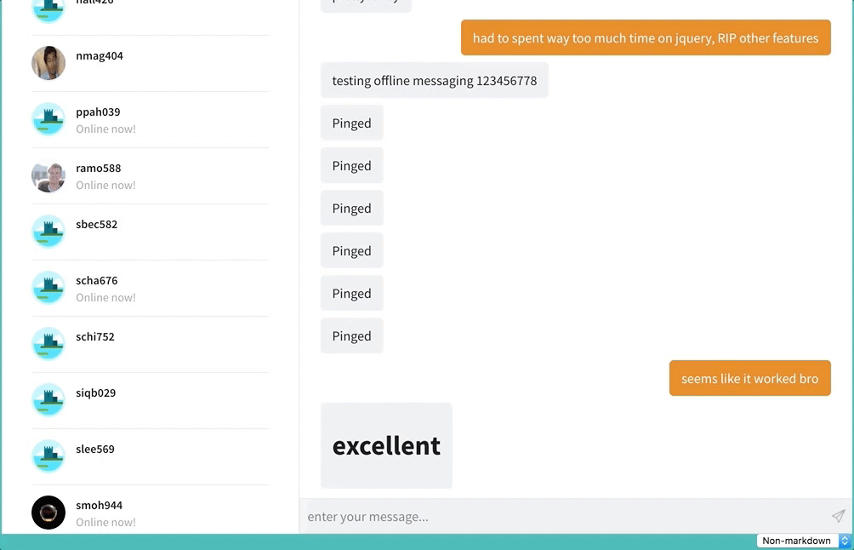
Special Features:
User Interface

Slide 8
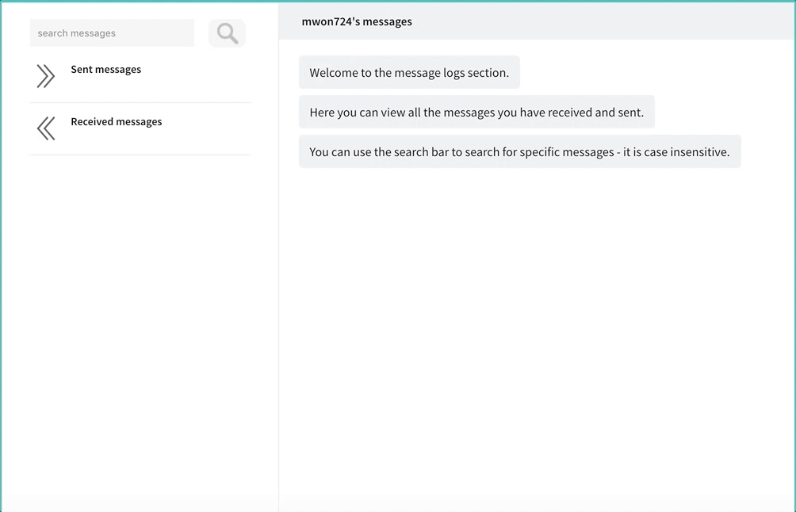
Special Features:
User Interface

Slide 9
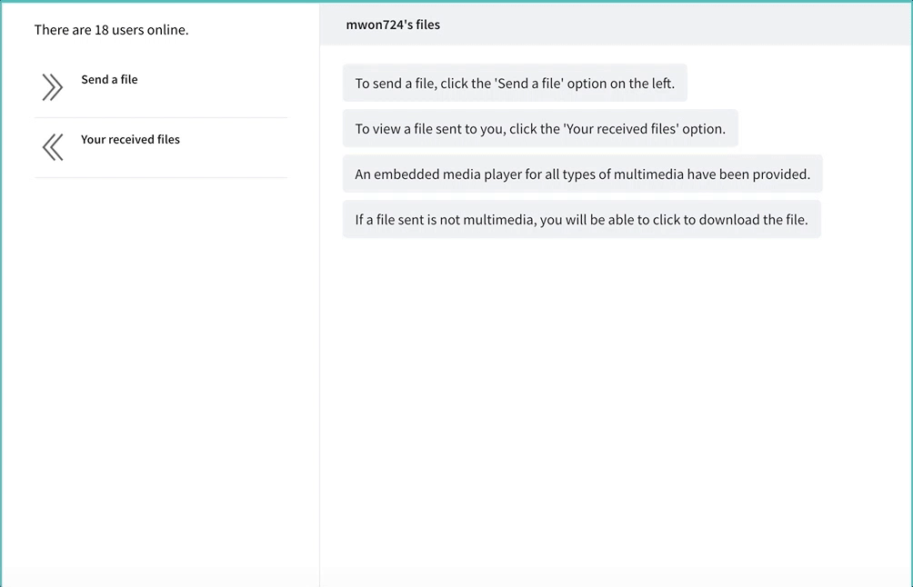
Special Features:
User Interface

Slide 10
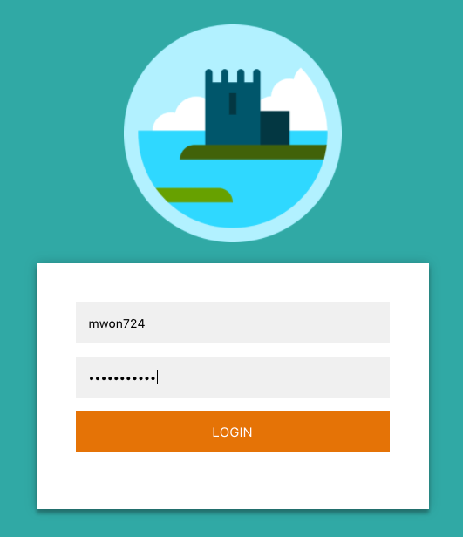
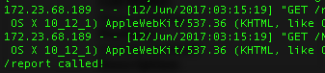
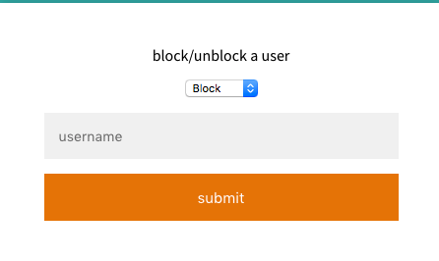
Special Features:
Backend
Improvements
Force logoff on application exit, threading for regular login server communication
Rate limiting and black listing
Modular and session-dependent code, support for simultaneous users

Slide 11
Met Project Requirements?
Yes, with plenty of progress made towards more complex features
Functional inter-app communication for profiles, messages and files
Backend improvements to improve usability
Additional security from 2FA

